Slide 1
Early Years Survey 2024
Results

Slide 2
Overview
Survey opened from 3 June until 22 October 2024
A total of 80 parents completed the survey
  69 for 3 and 4 year old kindergarten
  11 for Occasional Care
Shared via:
  Surf Coast Shire website
  Early Years Facebook page
  Educa – Kindergarten communication platform
  Xplor – Occasional Care communication platform

Slide 3
Why do we ask families to complete the survey?
In 2012, the National Quality Framework (NQF) was introduced to improve education and care across long day care, preschool/kindergarten and outside school hours care services.
The NQF includes:
National Law and National Regulations
National Quality Standards
Assessment and quality rating process
National learning frameworks.
Quality Area 6 – Collaborative partnerships with families and communities
Standard 6.1 – Supportive relationships with families
Standard 6.2 – Collaborative partnerships
  Element 6.2.3 – Community Engagement – The service builds relationships and engages with its community.

Slide 4
Kindergarten – Positive Results
Areas of strength:
  Teaching staff
  Embedding first nations culture into programs
  Bush kinder
The Bush Kinder program has been our son’s favourite. It gives him the chance to explore nature and learn about the environment, including animals, insects and fungi. The program has also helped him expand his friendship group, as the outdoor setting is so different from the usual kinder space. Each session feels like a new adventure for him and now he’s looking forward to starting Beach Kinder next term.
Aboriginal and Torres Strait Islander perspectives are embedded into the educational program in a variety of engaging ways. Our son has learnt about traditional custodians through Acknowledgement of Country and explored culture and history with stories and songs.
He’s also benefited from the visit of a member of the Wadawurrung community and has connected with the environment through the bush kinder program. Together, these experiences have helped him understand and appreciate the deep connection to Country and culture.
It didn’t take long for our son to feel safe and comfortable at kinder, and he quickly started connecting with his teachers. It’s been wonderful to see him build trust with them, feeling respected and loved. He often talks about them at home. We’ve also felt well supported whenever we discuss his learning.

Slide 5
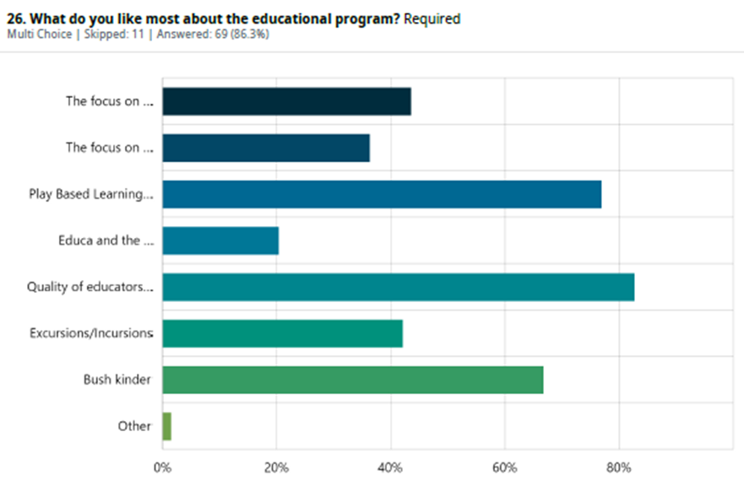
Kindergarten – Positive Results
Top 3 things most liked about the Educational Program
  Quality of educators
  Play based learning program
  Bush Kinder programs
The “Quality of our educators” is what families like most about the educational program. (82%)

Slide 6
Kindergarten - Family comments
Our child's interests are always supported by the educators who encourage him to explore and enjoy his learning. His cultural background is welcomed, celebrated, and shared with the rest of the group. Incursions and excursions have introduced him to new levels of learning and engaged him with specific subjects and the community. The bush kinder program has allowed him to deepen his love for nature and build a respect for the environment.
A calm, inclusive learning environment. Can clearly see the effort and thought that goes into planning the environment and the learning activities to foster learning and support children socially and emotionally.
Aboriginal and Torres Strait Islander perspectives are embedded into the educational program in a variety of engaging ways. Our son has learnt about traditional custodians through Acknowledgement of Country and explored culture and history with stories and songs. He’s also benefited from the visit of a member of the Wadawurrung community and has connected with the environment through the bush kinder program. Together, these experiences have helped him understand and appreciate the deep connection to Country and culture.
My child has epilepsy. I've had multiple opportunities to sit down with staff to discuss it and to communicate our management plan and it really feels like the educators are all on board and vigilant about her safety. When a staff member left in the middle of the year, the new staff member took the time to chat with me about my child's condition to really understand her role in looking after her. Everyone has been nothing but fantastic.

Slide 7
Kindergarten - Improvements
Areas for improvement:
  Teacher/parent catch ups
  Upgrades to facilities, especially toilets.
  40% of parents aren’t aware of QIP
  68% of parents had not heard of the State Government Reforms.
We have been given the option to make a time to catch up with the educator if needed. Last year we were offered a scheduled mid year catch up time slot, however I know not all classes were offered this which created some disappointment in other families. The general feedback was to have a consistent approach across all rooms/educators and this seems to have happened this year which is great.
We briefly see the teachers at the beginning and end of each session where I could take the opportunity to discuss my daughters learning if I needed too. However I would love the opportunity to have a more in depth discussion when appropriate to understand how my daughter behaves and learns best in this environment where I never really witness it.
I find it very difficult to communicate with the educators. We are the end of term 3 and I’ve never really had a conversation with either educator. (Aside from the initial meeting in February). I assume this is because my daughter is very happy and content at kinder, but it would new nice to get some occasional feedback about her day.
I haven't needed to discuss my kids learning and development, but it hasn't been clearly offered either..

Slide 8
Parent Education
The top 5 topic that parents expressed interest in attending were:
  Building resilience
  Developing healthy boundaries for kids
  Responding to challenging behaviours in pre-schoolers
  Strategies supporting children with anxiety
  Preparing for the transition to school
When asked how parents would like to attend parent education sessions:
51% wanted online sessions
22% requested in person
25% had no preference
Most people suggested sessions to run after 7pm on a week night, some interest in session during week days in the mornings and a couple suggested for webinars or recorded sessions that can be accessed anytime.

Slide 9
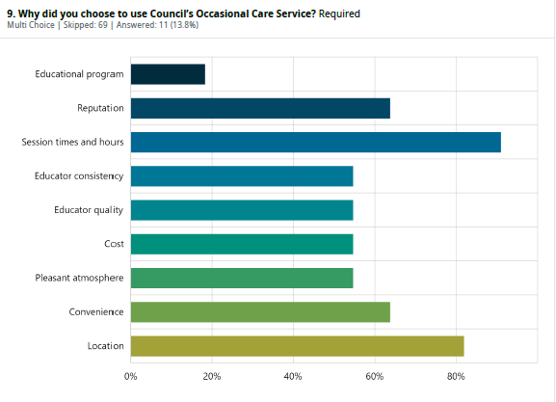
Occasional Care – Positive Results

Slide 10
Occasional Care – Results
Standout compliments:
Outdoor space and equipment is awesome the children love it.
Educators are very friendly and welcoming.
The occasional care area is perfect. Many different activities are on offer to keep children stimulated and happy.
Standout compliments:
‘Great at distracting upset children upon drop off.’
‘I love the small group dynamic and the consistency that Occasional Care offers for our daughter. She feels supported and has gained in confidence since attending Occasional Care at KMCC.’
Areas for improvement:
There were very few comments regarding improvement. The only comments were:
Would love afternoon sessions
Sessions should be longer
Waitlist is too long

Slide 11
Customer Service Feedback
Kindergarten customer service:
  Approx 75% of people found that customer service officers were always friendly and helpful
  Approx 70% of people found that customer service officers could always answer questions or connect them with someone who can
  Approx 75% found that the online central application and enrolment process was easy.
Occasional Care customer service:
  100% of people surveyed said they always found customer services officer to be friendly and helpful.
  90% said customer service officers are always able to answer questions, or connect them with someone who could.
‘I have always had friendly and very responsive service from all staff in the customer service team. They are wonderful !’
‘AMAZING customer service The BEST office staff Kind caring helpful Especially supportive to our family in a difficult time’
‘I have always been able to get onto someone straight away who was helpful and pragmatic with my requests. this includes emails I sent while we were still living overseas and I was enquiring about enrolling for when we moved back.’

