Slide 1
Early Years Survey 2023
Results

Slide 2
Overview
Survey opened from Monday xxx until Friday xxx 2023
A total of 348 parents completed the survey
205 for 3 and 4 year old kindergarten
89 for Maternal and Child Health
54 for Occasional Care
Shared via:
Surf Coast Shire website
Early Years Facebook page
Educa – Kindergarten communication platform
Xplor – Occasional Care communication platform

Slide 3
Why do we ask families to complete the survey?
In 2012, the National Quality Framework (NQF) was introduced to improve education and care across long day care, preschool/kindergarten and outside school hours care services.
The NQF includes:
National Law and National Regulations
National Quality Standards
Assessment and quality rating process
National learning frameworks.
Quality Area 6 – Collaborative partnerships with families and communities
Standard 6.1 – Supportive relationships with families
Standard 6.2 – Collaborative partnerships
Element 6.2.3 – Community Engagement – The service builds relationships and engages with its community.

Slide 4
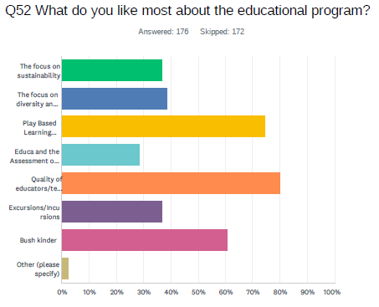
Kindergarten – Positive Results
Top 4 things most liked about the Educational Program
Quality of teachers
Play based learning program
Bush/Beach Kinder programs
Focus on diversity and inclusion
The “Quality of our educators” is what families like most about the educational program. (80%)

Slide 5
Kindergarten – Positive Results
They do this really well. Just through embedding little things, like stories, songs, games, learning words and symbols. It makes it seem like a natural part of their education.
Daily references are made to the Aboriginal and Torres Strait Islander land upon which the Preschool is located. There is a dedicated play space within the kinder room that contains books, sensory objects, flags and other toys from Aboriginal and Torres Strait Islander culture which the children are free to explore. Frequent art experiences are available to students, using resources from nature and indigenous perspectives are highlighted and discussed during these activities.
My daughter has taught us things about Aboriginal and Torres Strait Islander culture and often discusses new words she has learnt or there are visiting staff who provide education for the children
Successfully - however some of the teachers cover this more in-depth than others in my experience.

Slide 6
Kindergarten - Family comments
My child is sensitive and did not speak English at the start of the year. The educators have done a fantastic job in making sure he is not overwhelmed and in reassuring him and including him in group activities.
The staff are warm, nurturing, caring and compassionate. They challenge my child to do hard things, provide encouragement and support. They support my child to separate from me, even when it is difficult and sometimes sad. They have a clear understanding on my child's interests, needs and areas for improvement and have taken deliberate steps to support him to work on these. The outdoor environment beyond the yard is utilised to support development of the children in all areas - relationships, confidence, risk-taking, communication, exploration, investigation.
Very supportive of my child with additional needs. Teachers are very open and receptive, also proactive in providing suggestions and solutions. The classroom environment is very calm and organised which is fantastic. The kids are very respectful, attentive and settled.
Our daughter has been thoroughly engaged since day 1. The consistency of weekly updates and communications with parents from our teacher has been great, which has provided us the ability to continue the learnings/discussions at home.
My child is always excited about the opportunities kinder brings and the fun activities they will take part in. She loves bush kinder!

Slide 7
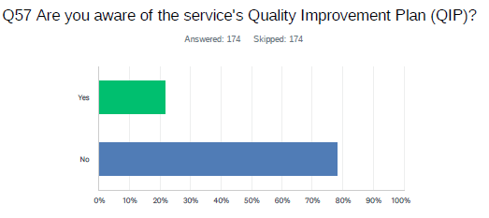
Kindergarten - Improvements
Areas for improvement
QIP – there’s confusion between Educa & QIP input methods.
Staff feedback for parents re: children’s individual progress.
Nude foods explained across all programs.
Handbook info put on Educa.

Slide 8
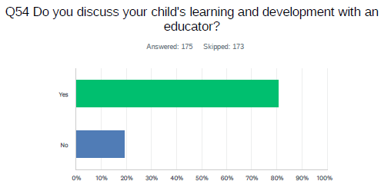
Kindergarten - Improvements
Families would like:
more longer day sessions offered as option.
reports provided mid & end year.
more intentional learning communication/information from Bush/Beach kinder across all programs.

Slide 9
Kindergarten - online central application process
Since the upgrade it is 110% better.
It was well organised and straightforward.
It was very straight forward and when I made enquiries all personnel were extremely helpful.
Areas for improvement
A confirmation email or text that outlines your selection would be greatly appreciated.
Next step: Liaise with EnrolNow to create email confirmation confirming selections
It would be great to have an option to indicate if you are going to have siblings attending at the same time.
Next step: Add extra question on the application form regarding siblings.

Slide 10
Parent Education
The top 5 topic that parents expressed interest in attending were:
Building resilience
Preparing for the transition to school
Responding to challenging behaviours in pre-schoolers
Developing healthy boundaries for kids
Strategies supporting children with anxiety
When asked how parents would like to attend parent education sessions:
26% said they would like to attend in person
30% said via online platforms
44% said either option is good
The preferred time for parent education to occur is on a weekday after 7pm.

Slide 11
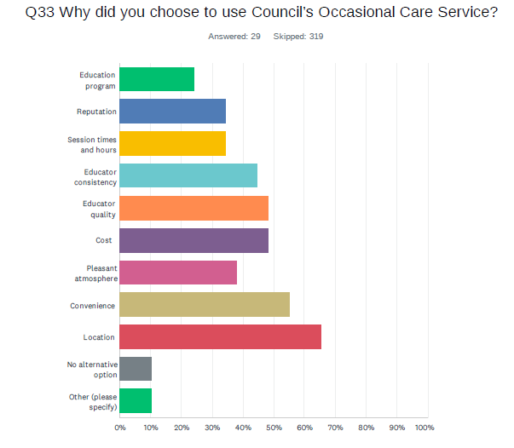
Occasional Care – Positive Results

Slide 12
Occasional Care – Positive Results
Q43. Overall, do you have any other comments regarding the Occasional Care service?
“Love the outdoor yard – staff make it look so inviting with a range of activities available to the children.”
“Fabulous service. Wonderful, caring and compassionate staff. Thoughtful and engaging sensory and play activities for children. We love occasional care!”
“I love the service and the educators. The children really love it there and it really helps with integration into kinder as well. They are always happy to go to occasional care."
“Exceptionally happy with this wonderful and welcoming service.”
“This service has been absolutely fantastic. I wish I had of known about it for my eldest daughter. All the educators are so kind and amazing with the children. The space is great and always getting changed around for new things for the children to do. Thank-you”
“We love it! Both the Hub and KMCC are great and it’s nice that educators work across both centres so children get even more familiar with them.”

Slide 13
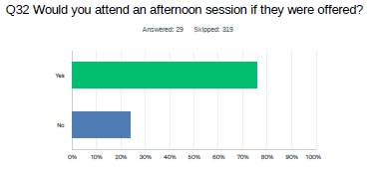
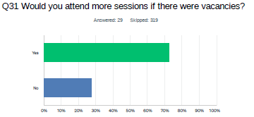
Occasional Care – Improvements
Things we can work on:
Afternoon sessions are requested. 75% in this years survey said they would attend an afternoon session and a similar number last year expressed interest.
Not enough days/spots available I can see how my child enjoys going there and learning so much but can only go once a week as no more available.
I know the waitlist is very long. I have a 1yo hoping to get a spot for next year. If you have the staff, it would be fabulous to offer more sessions.
Would love for the service to run for 6 hours.

Slide 14
Customer Service Feedback
M&CH customer service feedback was overwhelmingly positive with some of the comments:
“Customer service officers are friendly and helpful”.
“Customer services officers are able to answer my questions, or connect me with someone who can.”
Occasional Care customer service feedback was extremely positive:
“Exceptional service always from the girls at reception.”
“Amazing customer service.”
“5 star service from the team. Very friendly, great communication.”
“Fantastic customer service when accessing the Occasional Care program – staff are very knowledgeable and happy to answer any queries.”
Kindergarten customer service only had a few comments and they were :
“The customer service officers are proactive and a very valuable resource to families.”
“Excellent service, always kind.”

