Slide 1
Early Years Survey 2025
Results

Slide 2
Overview
Survey opened from 28 August until 31 October 2025
A total of 84 parents completed the survey
  63 for 3 and 4 year old kindergarten
  21 for Occasional Care
Shared via:
  Surf Coast Shire website
  Early Years Facebook page
  Kinderloop – Kindergarten communication platform
  Xplor – Occasional Care communication platform

Slide 3
Why do we ask families to complete the survey?
In 2012, the National Quality Framework (NQF) was introduced to improve education and care across long day care, preschool/kindergarten and outside school hours care services.
The NQF includes:
National Law and National Regulations
National Quality Standards
Assessment and quality rating process
National learning frameworks.
Quality Area 6 – Collaborative partnerships with families and communities
Standard 6.1 – Supportive relationships with families
Standard 6.2 – Collaborative partnerships
  Element 6.2.3 – Community Engagement – The service builds relationships and engages with its community.

Slide 4
Kindergarten – Positive Results
The inclusion of skilled professionals to provide educational experiences to the children - outside of the scope of the educators – is invaluable. The incursions have bought in opportunities for the children to grow and learn, make connections with people / programs from the wider community.
Areas of strength:
  Quality of Educators
  Bush kinder
  Play based learning
  Excursions/Incursions
Bush kinder is the absolute standout of the kinder program. My son has developed so much confidence from participating and he has made new friends. The program is very child led and I love that he has the opportunity to follow his own interests and instincts and cope with the weather!
The inclusive environment in which my children feels like he belongs and is a part of. He has agency over his experiences and has endless opportunities to be challenged, problem solve, investigate and engage in meaningful experiences with his peers and educators, through play-based learning.

Slide 5
Kindergarten – Positive Results
Top 3 things most liked about the Educational Program
  Quality of educators – 86%
  Bush Kinder programs – 83%
  Play based learning program – 81%
Play based learn program would be our favourite, the way the kids are involved, instead of seeing the boring side of learning, it's fun.
Educators - They are amazing and worth their weight in gold!
Flexible play based learning and weekly bush/beach kinder sessions in both 3 & 4 year old kinder have seen my child’s social and emotional skills develop so much during her time at kinder. The teachers have nurtured my child’s interests and provided age appropriate challenges for them.
I feel like the educators know and understand my child and treat him as an individual. They have identified areas he needs improvement and have supported us to help him.

Slide 6
Kindergarten - Family comments
I think the level of inclusion is fantastic. My child already knows about the First Nations people and it’s incorporated into their everyday. I appreciate the teachers sharing the changing seasons with us so we can discuss it at home.
The program really supports my son’s needs by giving him the right balance of guidance and independence. He’s naturally curious and loves to explore ideas, and the activities give him the chance to extend his learning at his own pace while still being supported when needed. The program also helps him socially, he’s building confidence in group settings, learning how to share ideas, and developing great friendships. Most importantly, he feels comfortable and happy in the environment, which means he’s willing to try new things and push himself.
I feel like the educators know and understand my child and treat him as an individual. They have identified areas he needs improvement and have supported us to help him.
The educators are always willing to have discussions about the children and learning. They are very approachable, and the children are always their primary focus.

Slide 7
Kindergarten – Best Start, Best Life
  56% of families were aware of the State Government Reform – Best Start, Best Life
  58% of families were aware of Surf Coast Shire Council’s roll out schedule
  62% of families said that they would use 30 hours of free kinder when it was rolled out
  38% of families said wouldn’t use the 30 hours because…..
I think preschool age is a very important time for kids to connect with parents, I don’t think 30 hours is necessary and takes away from the opportunity for time with parents and friends outside of the kinder community.
I feel this is too many hours 'out of the home' away from primary caregivers at this age.
30 hours would be too long for pre-prep in my opinion. If my children were to attend pre-prep I would have a preference for a maximum of 3 days across the week for a maximum time each day of 6hrs.
I feel 15-20hours is enough for this age group. Personally, I like my kids to have a good mix between kinder and time with parents at home on other days.

Slide 8
Kindergarten - Improvements
Areas for improvement:
  Casual teachers
  Bush Kinder intentional teaching focus
  Incursion/Excursion engagement equitable across groups
  44% of parents had not heard of the State Government Reforms.
I think preschool age is a very important time for kids to connect with parents, I don’t think 30 hours is necessary and takes away from the opportunity for time with parents and friends outside of the kinder community.
I would appreciate a small amount of info about who the casual teachers are and their qualifications.

Slide 9
Parent Education
The top 5 topic that parents expressed interest in attending were:
  Building resilience – 73%
  Developing healthy boundaries for kids – 64%
  Preparing for the transition to school – 51%
  Strategies supporting children with anxiety – 50%
  Responding to challenging behaviours in pre-schoolers – 46%
When asked how parents would like to attend parent education sessions:
46% wanted online sessions
27% requested in person
27% had no preference
Most families suggested sessions to run after 7pm on a weeknight or provide online recorded sessions that can be accessed anytime.

Slide 10
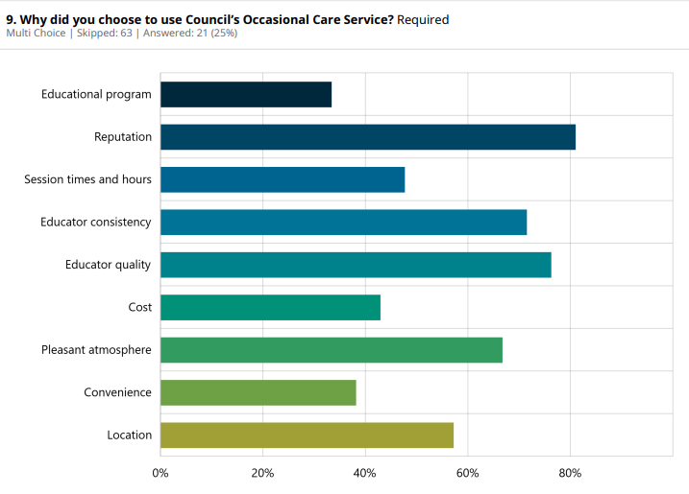
Occasional Care – Positive Results

Slide 11
Occasional Care – Results
Standout compliments:
Lots of options for indoor and outdoor play with a range of activities.
Customer service officers at both services are fantastic.
The educators are all so wonderful and would highly recommend the service.
We have been so impressed with Occasional care and the educators. We also value that it is not profit driven and that you do not use agency staff and that staff are consistent and committed.
The Occasional care program has been perfect for our child. This was her first time in any type of care outside her parents and the centre and the educators have been absolutely incredible to our child as well as us as parents.
My daughter has attended occasional care for 3 years. She loves going there, and had built a lovely connection to the educators. The diverse ages within the group has been wonderful, as the little ones get supported by the other kids, then they grow up to look after new little ones. It's a great atmosphere and there are always fun and interesting table set ups for the kids to play and learn.

Slide 12
Occasional Care – Results
Areas for improvement:
There were very few comments regarding improvement.
The only comments were:
Would love afternoon sessions
Sessions should be longer
Would attend more sessions if possible
Promote gender equity, cultural inclusion and disability awareness within the program.

Slide 13
Customer Service Feedback
Kindergarten customer service:
  78% said customer service officers are friendly and helpful.
  65% said customer service officers are able to answer questions, or connect them with someone who can.
Occasional Care customer service:
  95% said customer services officer to be friendly and helpful.
  95% said customer service officers are able to answer questions, or connect them with someone who can.
Approachable and easy to contact.
‘‘Everyone I have dealt with have been helpful, informed and warm.’
Customer service officers at both KMCC and Hub are fantastic. They are always so caring towards our family and have always answered any queries we’ve had. We feel part of a Community.
Customer Service goes above and beyond! Really wonderful communication - timely, honest, helpful and caring.

